Slide 1
Azure OpenAI Web API

Slide 2
Agenda
Azure OpenAI Service
REST API (Completions & embeddings)
REST API (authoring & deployment)
Azure OpenAI Service REST API reference - Azure OpenAI | Microsoft Learn

Slide 3
Azure OpenAI API Docs
Create completions for chat messages with the ChatGPT (preview) and GPT-4 (preview) models. Chat completions are currently only available with api-version=2023-03-15-preview
Create completions for chat messages with the ChatGPT (preview) and GPT-4 (preview) models. Chat completions are currently only available with api-version=2023-03-15-preview
Create completions for chat messages with the ChatGPT (preview) and GPT-4 (preview) models. Chat completions are currently only available with api-version=2023-03-15-preview
Create completions for chat messages with the ChatGPT (preview) and GPT-4 (preview) models. Chat completions are currently only available with api-version=2023-03-15-preview
Completions & Embeddings APIs
Completions: the model will generate one or more predicted completions based on a provided prompt.
Embedding: Get a vector representation of a given input that can be easily consumed by machine learning models and other algorithms.
Chat Completions: Create completions for chat messages with the ChatGPT (preview) and GPT-4 (preview) models.
swagger
Deployment APIs
Create, Delete, Get, List, Update
swagger
Notes:
https://learn.microsoft.com/zh-cn/azure/cognitive-services/openai/reference
https://learn.microsoft.com/zh-cn/rest/api/cognitiveservices/azureopenaistable/deployments/create?tabs=HTTP
AI BUILDER CONNECTOR
Azure OpenAI Service REST API reference - Azure OpenAI | Microsoft Learn
Deployments - Create - REST API (Azure Cognitive Services) | Microsoft Learn

Slide 4
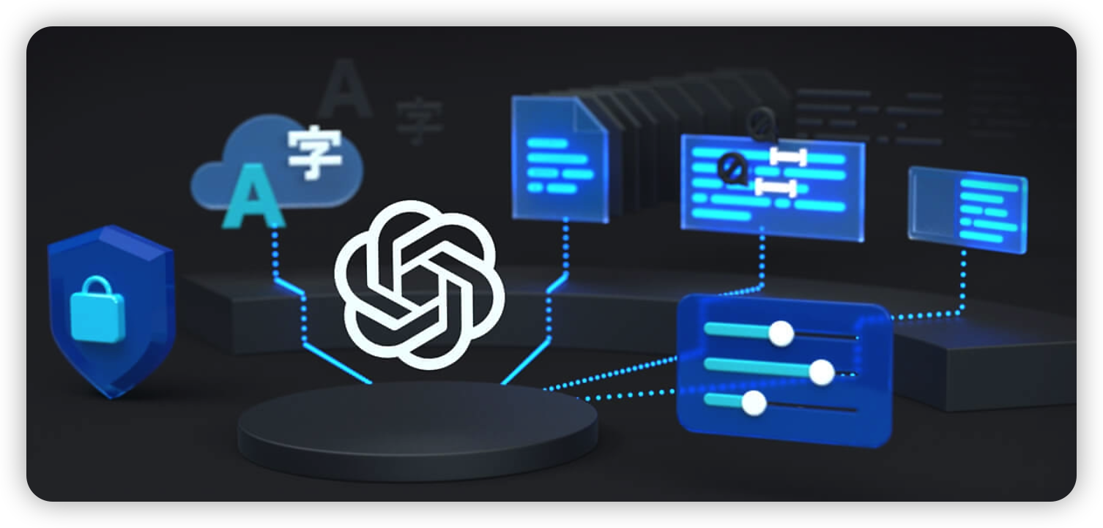
Azure OpenAI Completion API

Slide 5
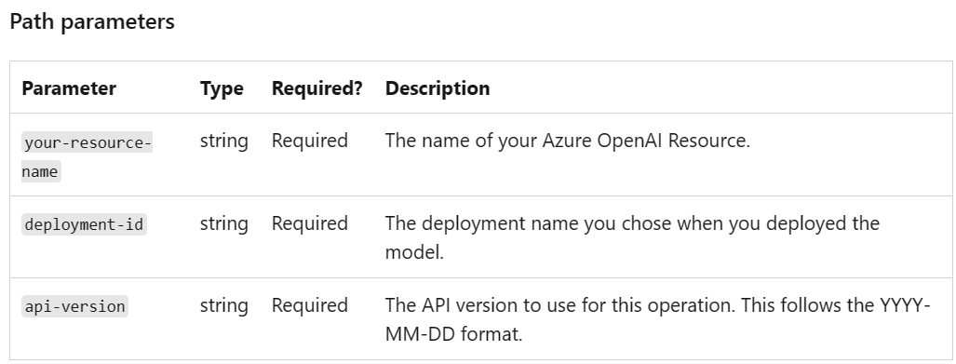
Azure OpenAI Completions API
POST
https://{your-resource-name}.openai.azure.com/openai/deployments/{deployment-id}/completions?api-version={api-version}
headers
“api-key”:” {secret key}”

Slide 6
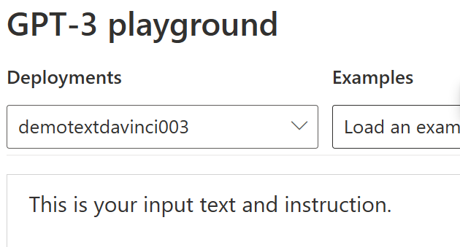
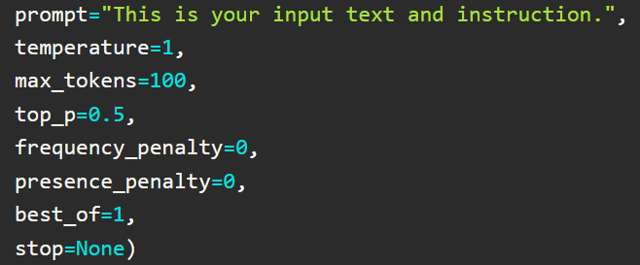
Azure OpenAI Completion API
Request Parameters Json

Slide 7
Azure OpenAI Copmletion API
Request Parameter | Description
model | ID of the model to use
prompt | The prompt(s) to generate completions for
max_token | The maximum number of tokens to generate
temperature | Sampling temperature to use. Higher values means the model will take more risks. Try 0.9 for more creative applications, and 0 (argmax sampling)
top_p | An alternative to sampling with temperature, called nucleus sampling, where the model considers the results of the tokens with top_p probability mass.
n | How many completions to generate for each prompt
logprobs | Include the log probabilities on the logprobs msot likely tokens, as well the chosen tokens.
best_of | Generates best_of completions server-side and returns the "best" result.
user | A unique identifier representing your end-user

Slide 8
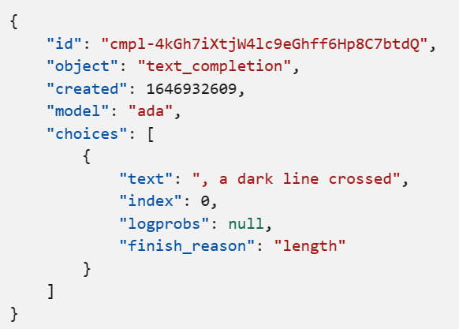
Azure OpenAI Copmletion API
Response Parameters Json
In the example response, finish_reason equals stop. If finish_reason equals content_filter consult our content filtering guide to understand why this is occurring.

Slide 9
Azure OpenAI Completions API
Response Parameters
Parameter | Description
Object | Completion Type，eg. chat、text
created | Timestamp of creation
model | Name of model
choices | Result set
text | Text content of result set
index | Index of result set

Slide 10
Azure OpenAI Deployment API

Slide 11
Azure OpenAI Deployment API
Category | Name | Mode | CURL | Desc | Example | 备注
Deployment | Create | POST | {endpoint}/openai/deployments?api-version=2022-12-01 | Creates a new deployment for the Azure OpenAI resource according to the given specification. | POST https://aoairesource.openai.azure.com/openai/deployments?api-version=2022-12-01 { "scale_settings": { "capacity": 2, "scale_type": "manual" }, "model": "curie" }
 | Delete | DELETE | {endpoint}/openai/deployments/{deployment-id}?api-version=2022-12-01 | Deletes the deployment specified by the given deployment-id. | DELETE https://aoairesource.openai.azure.com/openai/deployments/deployment-afa0669ca01e4693ae3a93baf40f26d6?api-version=2022-12-01
完成 | Get | GET | {endpoint}/openai/deployments/{deployment-id}?api-version=2022-12-01 | Gets details for a single deployment specified by the given deployment-id. | GET https://aoairesource.openai.azure.com/openai/deployments/deployment-afa0669ca01e4693ae3a93baf40f26d6?api-version=2022-12-01
编辑 | List | GET | {endpoint}/openai/deployments?api-version=2022-12-01 | Gets the list of deployments owned by the Azure OpenAI resource. | GET https://aoairesource.openai.azure.com/openai/deployments?api-version=2022-12-01
Notes:
Deployments - Create - REST API (Azure Cognitive Services) | Microsoft Learn

Slide 12
Azure OpenAI Deployment API
Category | Name | Mode | CURL | Desc | Example | 备注
Deployment | Update | PATCH | {endpoint}/openai/deployments/{deployment-id}?api-version=2022-12-01 | Updates the mutable details of the deployment with the given deployment-id. | PATCH https://aoairesource.openai.azure.com/openai/deployments/deployment-afa0669ca01e4693ae3a93baf40f26d6?api-version=2022-12-01 { "scale_settings": { "capacity": 1, "scale_type": "manual" } }
Model Attribute | List | GET | {endpoint}/openai/models?api-version=2022-12-01 | Gets a list of all models that are accessible by the Azure OpenAI resource. These include base models as well as all successfully completed fine-tuned models owned by the Azure OpenAI resource. | GET https://aoairesource.openai.azure.com/openai/models?api-version=2022-12-01
 | Get | GET | {endpoint}/openai/models/{model-id}?api-version=2022-12-01 | Gets details for the model specified by the given modelId. | GET https://aoairesource.openai.azure.com/openai/models/curie?api-version=2022-12-01

